Slide 1
NESTING
Considerations & Advantages for 3D Printing
Notes:
Instructor guidelines:
Goals:
Learn what does nesting means
Review nesting for 3D printing. Topics include why (advantages), considerations and how to nest in Stratasys’ Insight and Objet Studio software programs.
Understand the fundamentals through 2D nesting applications and builds on them to cover 3D nesting
Explain:
In this class we will discover the concept that will help you to make your 3D printers more productive that called nesting.

Slide 2
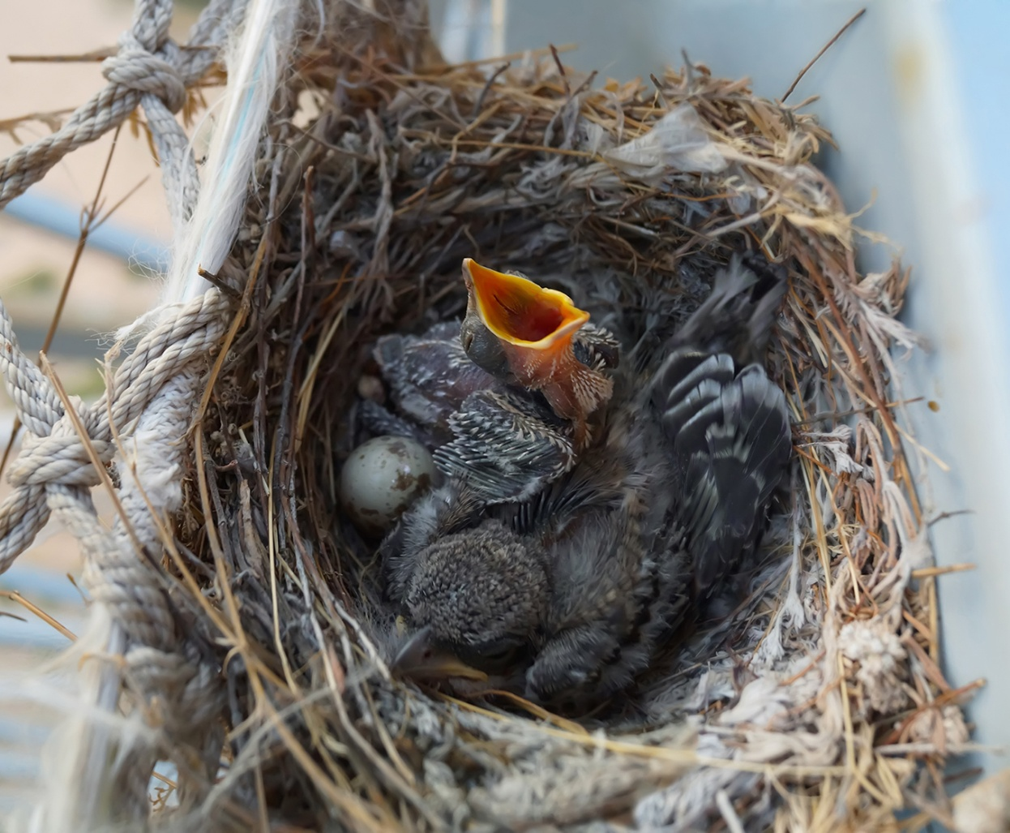
NESTING
Notes:
Instructor guidelines:
Explain:
The term and concept of nesting are assumed to be unknown to the students.
This slide is the first of many that build the fundamental concepts.
Refer to the image: Although we aren’t talking about this kind of nesting, there is one aspect of this image of baby birds in a nest that applies to the concepts we will discuss today: tightly packing as many bodies, or objects, as possible into the smallest space. That is nesting in a manufacturing and 3D printing context.

Slide 3
IN THIS LESSON
Nesting concepts: 2D
Nesting concepts: 3D
Nesting for 3D printing
PolyJet
Fused Deposition Modeling
Notes:
Instructor guidelines:
Explain:
Briefly describe the lesson’s content: start with 2D nesting concepts and build on them for 3D nesting; conclude with the nesting process for two Stratasys technologies.
This course has three sections:
We will start with 2D nesting to cover the basic advantages and considerations.
Then we will use that information to move into the 3D world.
Finally, we will look at the nesting process and considerations for Stratasys’ PolyJet technology, which jets photopolymer materials, and Fused Deposition Modeling, or FDM technology, which extrudes thermoplastics.

Slide 4
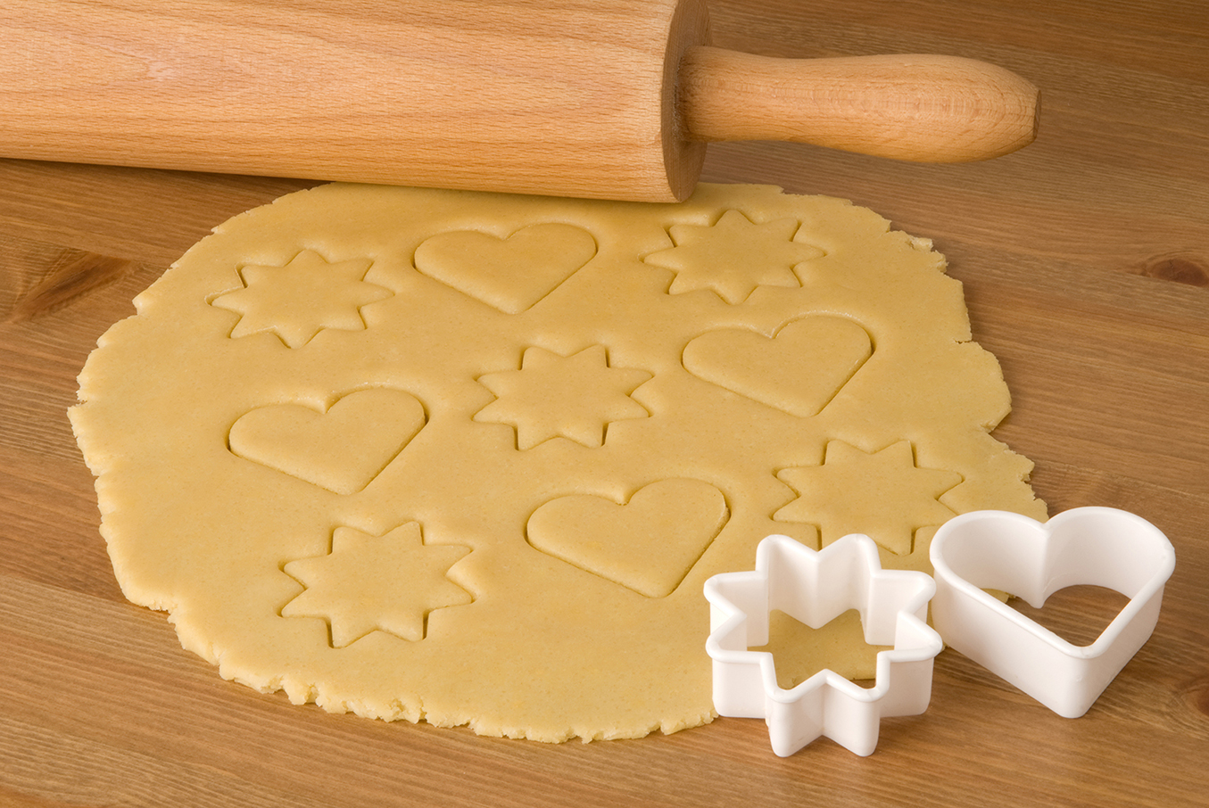
NESTING – 2D CONCEPTS
Notes:
Instructor guidelines:
Explain:
The 2D nesting concepts include:
Advantages
Less waste
Less motion/travel distance
Part space for same number of parts
More parts per operation
Considerations
Spacing between parts
Orientation
Using different parts to maximize material utilization
These are presented through
Cookie cutting
Fabric cutting
Woodworking
The concepts are then tied to 2D manufacturing methods
Instructor notes:
Explain: We are going to start with simple nesting concepts in the 2D world and build from them to 3D and then discuss nesting in the context of 3D printing. And what could be better than starting with everyone’s favorite treat, cookies!
Ask: What is the advantage of cutting the cookies as close together as possible?

Slide 5
NESTING - ADVANTAGES
Less waste
Less motion/travel
Less space
More items
Notes:
Instructor guidelines:
Discuss key advantages of nesting (in 2D)
Instructor notes:
Explain: Correct ( to the ones the stated).
Explain: And others are less waste, less motion, less space, more cookies per batch.
Explain: (explanations)
Less wasted dough: True that to some extent you could ball all of leftover dough, roll it out again and cut more cookies. But that wastes energy and takes more time. And in the world of manufacturing, that often isn’t possible. You have to discard the material or send it out for recycling.
Less motion: Smaller arm movements across the rolled out dough. This reduces time and the energy expelled. Which makes the process more efficient…always a good thing in manufacturing
More done in less space: You only have so much counter space to roll out the dough, so nesting lets you get more work done per operation in the same amount of space.
More cookies per batch: by nesting the cookies tightly, you will get more of them from each operation. In the world of manufacturing this is called increasing throughput.

Slide 6
NESTING - ADVANTAGES
Less waste
Less motion/travel
Lower cost
Less space
More items
Notes:
Instructor guidelines:
Discuss key advantages of nesting (in 2D)
Instructor notes:
Explain: And when combined, that yields the most important advantage, lower cost.

Slide 7
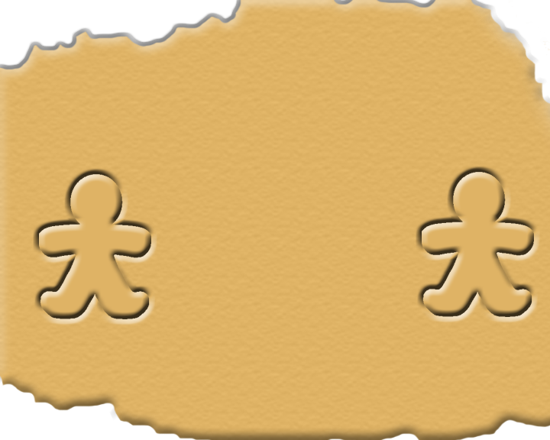
NESTING -2D
Notes:
Instructor guidelines:
The next three slides continue with the discussion through the concept of cookie making. Using gingerbread men, less waste, less energy, and more cookies are clarified. It also opens the door to the consideration of orientation.
Instructor notes:
Explain: Let’s stay with the cookie concept and apply nesting to making gingerbread men. If we space them far apart:
Fewer fit in the space allowed and there is a lot of waste
And our arm has to move farther, taking more energy

Slide 8
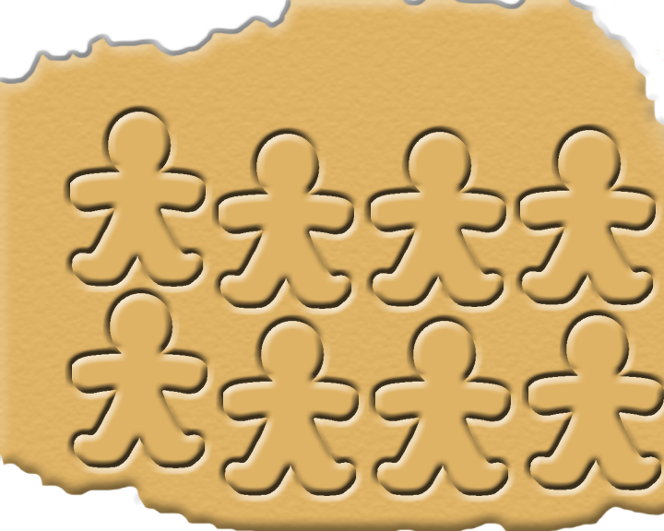
NESTING -2D
Notes:
Instructor guidelines:
The next two slides continue with the discussion through the concept of cookie making. Using gingerbread men, less waste, less energy, and more cookies are clarified. It also opens the door to the consideration of orientation.
Instructor notes:
Explain: We can fix that If we pack them tightly. Doing that maximizes the yield from a single sheet of dough. But there still is quite a bit of waste.

Slide 9
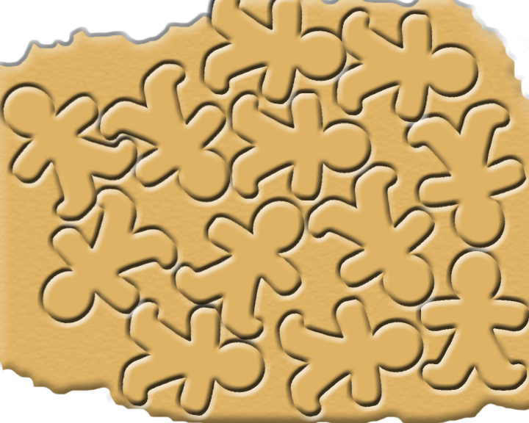
NESTING -2D
Notes:
Instructor guidelines:
This slide continue with the discussion through the concept of cookie making. Using gingerbread men, less waste, less energy, and more cookies are clarified. It also opens the door to the consideration of orientation.
Instructor notes:
Explain: To get the tightest nesting possible… to get the most gingerbread men with the least effort and waste, we change the orientation of each cookie. Instead of 8 cookies as shown on the previous layout, we now get 12, a 50% increase.

Slide 10
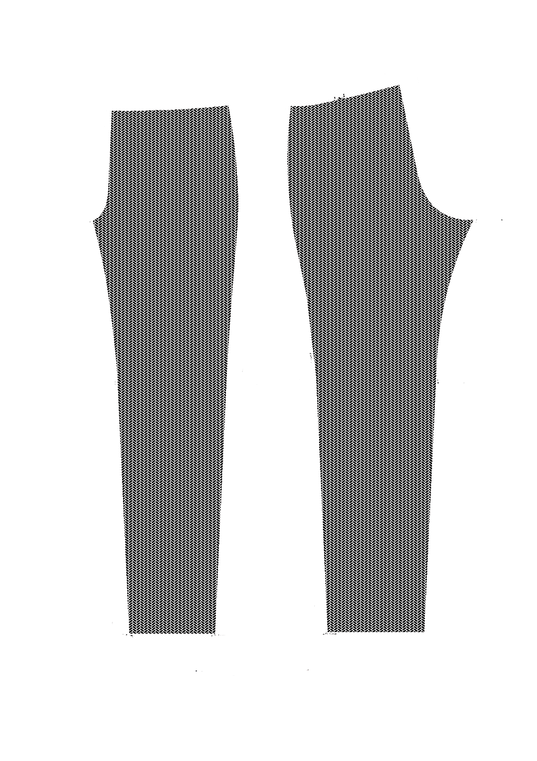
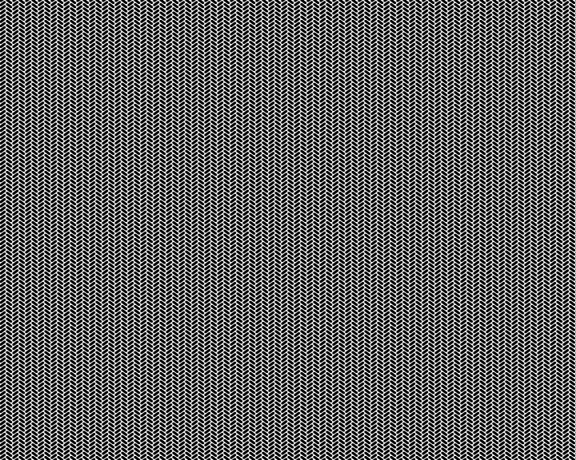
NESTING -2D
ORIENTATION
Pattern direction
Notes:
Instructor guidelines:
The next two slides use fabric cutting for clothing as nesting examples. The intent with this is to convey that random part orientation isn’t always possible.
Instructor notes:
Explain: Nesting also applies to clothes making. As with the cookies, you want to maximize the yield from each yard of fabric.
Explain: Here we have the patterns for a pair of pants and a swatch of a herringbone fabric that will be used to make the pants.
Ask: What is the new consideration that wasn’t true with the cookies?
.

Slide 11
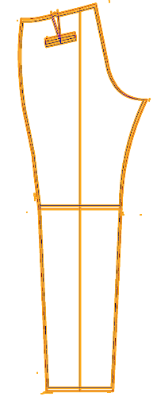
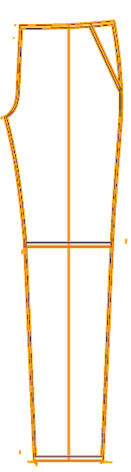
NESTING -2D
ORIENTATION
Notes:
Instructor guidelines:
This slide continues the fabric cutting for clothing as nesting examples. The intent with this is to convey that random part orientation isn’t always possible.
Instructor notes:
Explain: Correct. We have to consider the pattern of the material. We wouldn’t want the “grain” of the herring bone to be horizontal for some pants and not others.
Click: for slide animation
Explain: So in this example, me are forced to have more waste and fewer “waste lines” from the same amount of fabric.

Slide 12
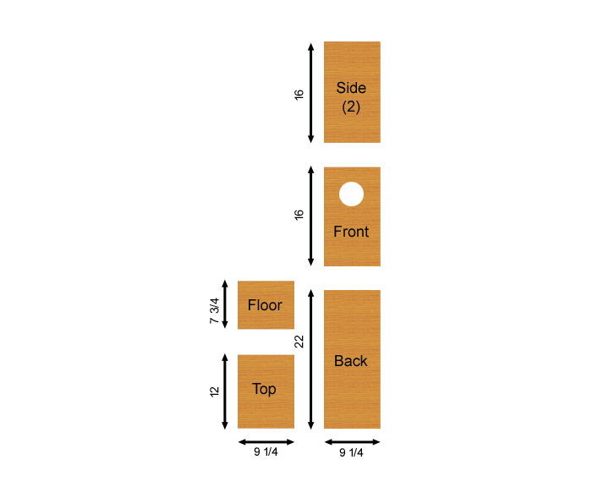
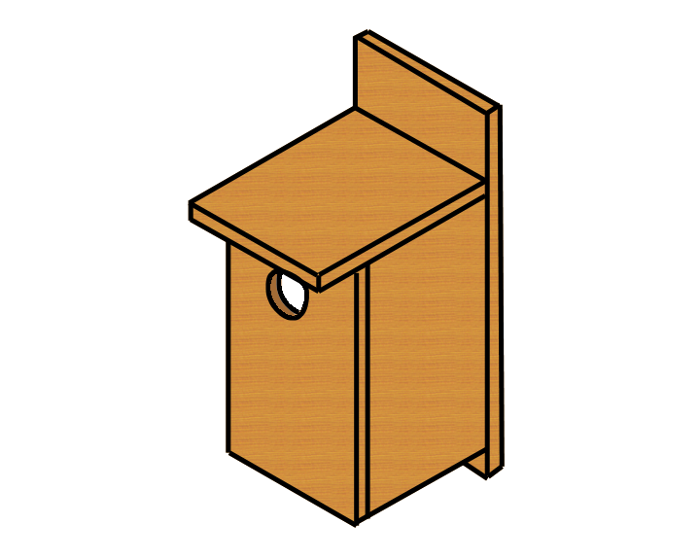
NESTING -2D
Notes:
Instructor guidelines:
The next two slides shift to wood working. Using a birdhouse as an example, orientation is reinforced and the concept of needing space between parts is introduced.
Instructor notes:
Explain: Nesting is also a valuable tool for wood working. Let’s take a simple example of a bird house (right) and its pieces (left).

Slide 13
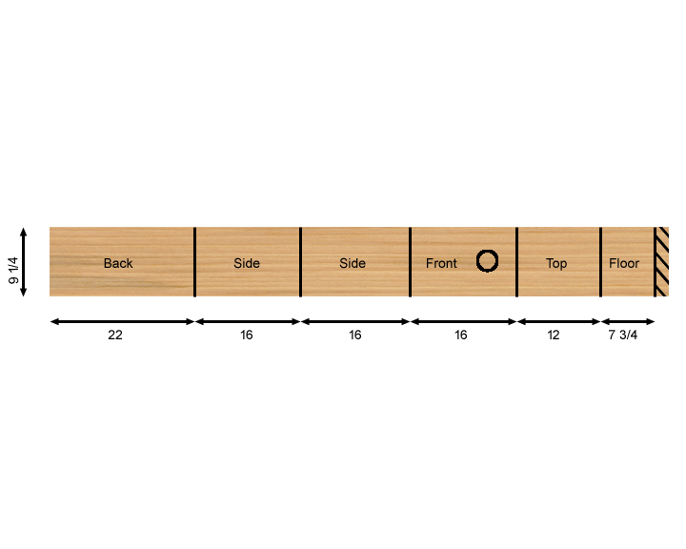
NESTING -2D
ORIENTATION & SPACING
Notes:
Instructor guidelines:
This slide continues the wood working example. Using a birdhouse as an example, orientation is reinforced and the concept of needing space between parts is introduced.
Instructor notes:
Explain: This bird house was designed to get the most out of a single 1” X 10” x 8 foot piece of lumber.
Explain: Orientation, as with fabric, is also a consideration due to the grain of the wood. For aesthetics, you want the grain to go in the same direction, which it will for our bird house. But there is also a strength consideration. You want to align such that forces go across, not with the wood grain, which is the weak point of lumber. But this doesn’t apply to the bird house, so it isn’t a consideration.
Explain: For work efficiency, the pieces a butted one to another. This means less work since one cut for each piece is all that is needed.
Ask: What is the downside of that?
Explain: The layout doesn’t account for the thickness of a saw blade! That means that each piece will be slightly shorter than called for. This concept of spacing parts with the process in mind applies to 2D manufacturing processes and 3D printing, as we will discuss later.

Slide 14
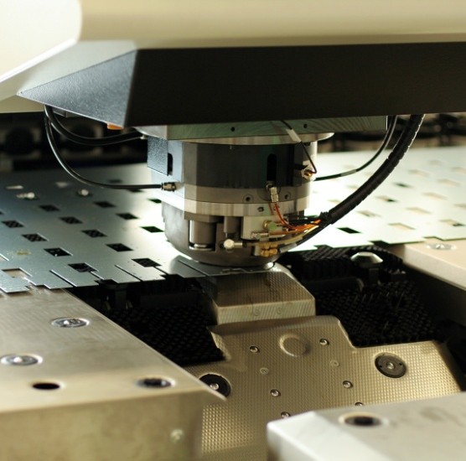
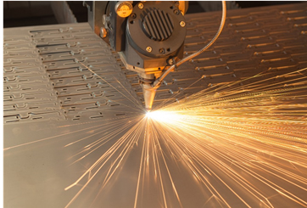
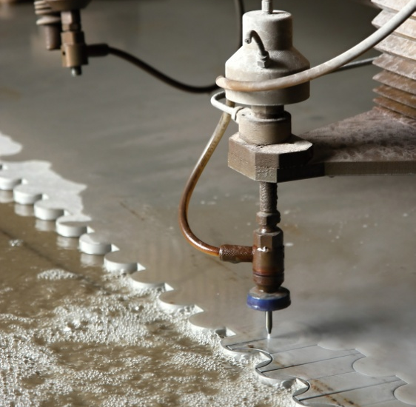
2D NESTING - Manufacturing
SHEET METAL STAMPING
LASER CUTTING
WATERJET CUTTING
Notes:
Instructor guidelines:
Now shift the 2D nesting concept to manufacturing operations to make the conversation more “practical.”
Instructor notes:
Explain: Nesting is critical for many 2D manufacturing operations, including:
Sheet metal stamping: A die punches through sheet metal to cut out parts, which are later bent into final shapes.
Laser cutting: A high energy laser cuts 2D shapes of metal parts in plates that can be an inch or more thick
WaterJet cutting: Same thing as laser cutting, but a high pressure jet of water, that contains an abrasive, cuts through metal plate.
Ask: Can you think of any other 2D manufacturing operations where nesting is important?
Explain: How about glass cutting; packing where cardboard is cut in a flat sheet and bent into shape.

Slide 15
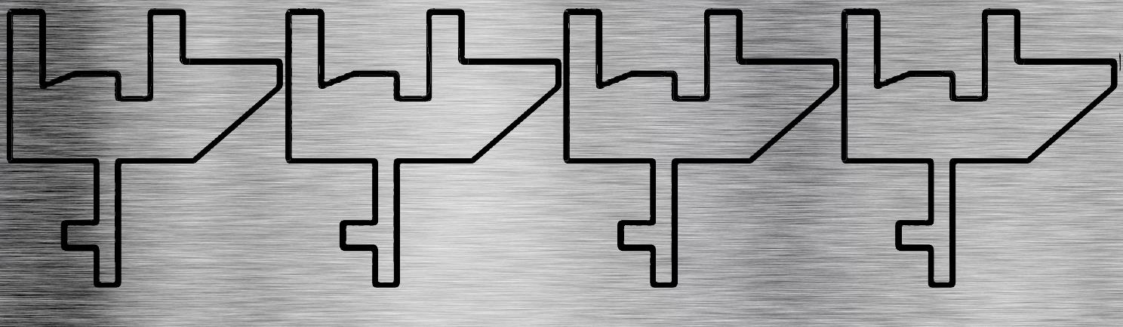
2D NESTING - Manufacturing
ORIENTATION
Grain direction
Notes:
Instructor guidelines:
The sheet metal layout will reinforces the concepts of minimizing waste, orienting parts, spacing and adding parts into unused areas.
Instructor notes:
Explain: Here we have a strip of sheet metal with four copies of a part that have been nested.
Click: Slide animation
Explain: Note that some space between the parts has been provided. This spacing will be dictated by the machine, die, material, part design and overall process.
Click: Slide animation
Explain: Although more parts could have been place on the strip with different orientations, that may not be a good idea. Like wood, sheet metal has a grain, and bending with or against the grain has some affect on manufacturing processes like bending on a press brake. So in this case, we have a fair amount of scrap.

Slide 16
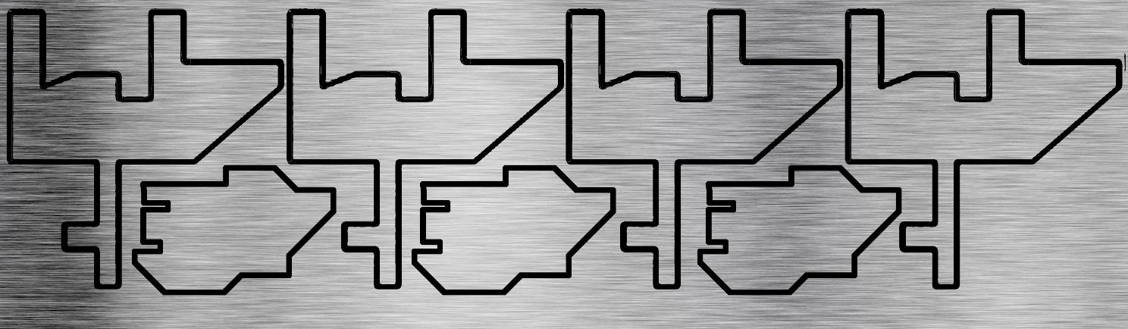
2D NESTING - Manufacturing
PART COMBINATIONS
Notes:
Instructor guidelines:
Using sheet metal layout, will reinforce the concepts of minimizing waste, orienting parts, spacing and adding parts into unused areas.
Instructor notes:
Explain: Until now, we’ve considered nesting of multiple copies of a single part. But for the least waste, it often requires that different parts are nested on the same sheet, as shown here.
Explain: While nesting is a simple concept, there is a lot of thought that goes into optimization to minimize time and cost.

Slide 17
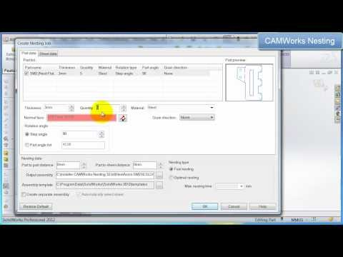
NESTING – AUTOMATIC LAYOUT
Notes:
Instructor guidelines:
Introduce students to automated nesting tools for 2D applications
Instructor notes:
Explain: Which is why there are quite a few software packages that automate nesting. Let’s watch a short video that shows the process.
Click video: Play video
Explain: <during video>
0:16 – define the number of parts needed
0:20 – define how much space to allow between parts
0:30 – define the size of the sheet of metal
0:40 – nesting begins
0:47 – PAUSE. That’s an optimized nest. 124 parts with very little waste.

Slide 18

KNOWLEDGE CHECK
What are the advantages of nesting?
Notes:
Explain: Let’s complete a quick Knowledge Check.
Ask: What are the advantages of nesting?

Slide 19
KNOWLEDGE CHECK
What are the advantages of nesting?
Less waste
Lower cost
Less motion/travel
Less space
More parts
Notes:
Explain: Correct. The advantages are:
Less waste
Less motion/travel
Less space
More parts
Which combine to lower the cost per part.

Slide 20
KNOWLEDGE CHECK
What are the considerations when nesting?
Notes:
Explain: And one more Knowledge Check: What are the considerations when nesting?

Slide 21
KNOWLEDGE CHECK
What are the considerations when nesting?
Orientation
Distance
Multiple parts
Notes:
Explain: Correct. Orientation may come into play, depending on the process and material. We also have to consider the space needed between parts and be open to adding different parts to minimize scrap.

Slide 22
KNOWLEDGE CHECK
Which ones would apply to 3D nesting?
Considerations
Advantages
Orientation
Less waste
Distance
Less motion/travel
Multiple parts
Less space
More parts
Lower cost
Notes:
Explain: Now for some reasoning skills. Of the considerations and advantages for 2D nesting, which ones will apply to 3D manufacturing processes?

Slide 23
KNOWLEDGE CHECK
Which ones would apply to 3D nesting?
Considerations
Advantages
Orientation
Less waste
Distance
Less motion/travel
Multiple parts
Less space
More parts
Lower cost
Notes:
Explain: That’s correct. All of them.
Explain: And we will learn why in the next section.

Slide 24
IN THIS LESSON
Nesting concepts: 2D
Nesting concepts: 3D
Nesting for 3D printing
PolyJet
Fused Deposition Modeling
Notes:
Instructor guidelines:
This section covers:
3D stacking
Considerations
Orientation
Spacing
Overlap
Multiple parts
Advantages
Waste reduction
Time reduction
Throughput increase
Instructor notes:
Explain: This course’s second sections, uses the 2D nesting concepts that we have covered and extends them out to 3D processes.

Slide 25
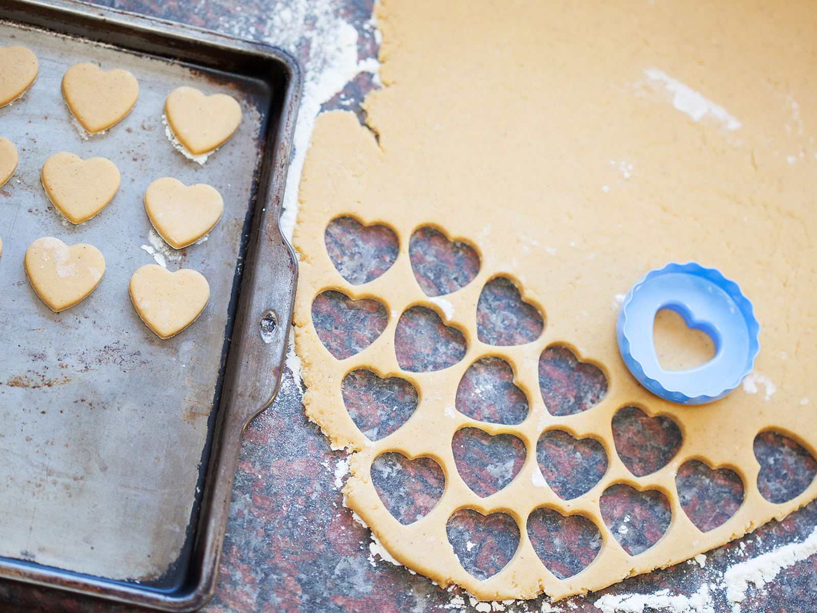
3D NESTING – COOKIE DOUGH OR COOKIE SHEET?
Notes:
Instructor guidelines:
To start the discussion for 3D nesting, first clarify that the thoughts, rules and considerations vary by process type.
Instructor notes:
Explain: When working in 3D, the concept of nesting can be similar to cutting cookies from dough or similar to placing cookies on a cookie sheet.
For 3D printers that add material, like PolyJet and Fused Deposition modeling, the analogy is to the cookie sheet. For 3D printers that bind materials, such as those in the binder jetting or powder bed fusion class, the analogy it is to cutting the cookie dough. But instead of removing material, the process changes the material characteristics.
Binder jetting lays down a layer of powdered material. Then an ink jet head deposits a binder on the powder. So the layer of powder is similar in concept to the rolled out cookie dough. Powder bed fusion also spreads a layer of powder, but an energy source, like a laser, fuses the powder.
With this in mind, the advantages and considerations are similar, but different, for each 3D printing technology.

Slide 26
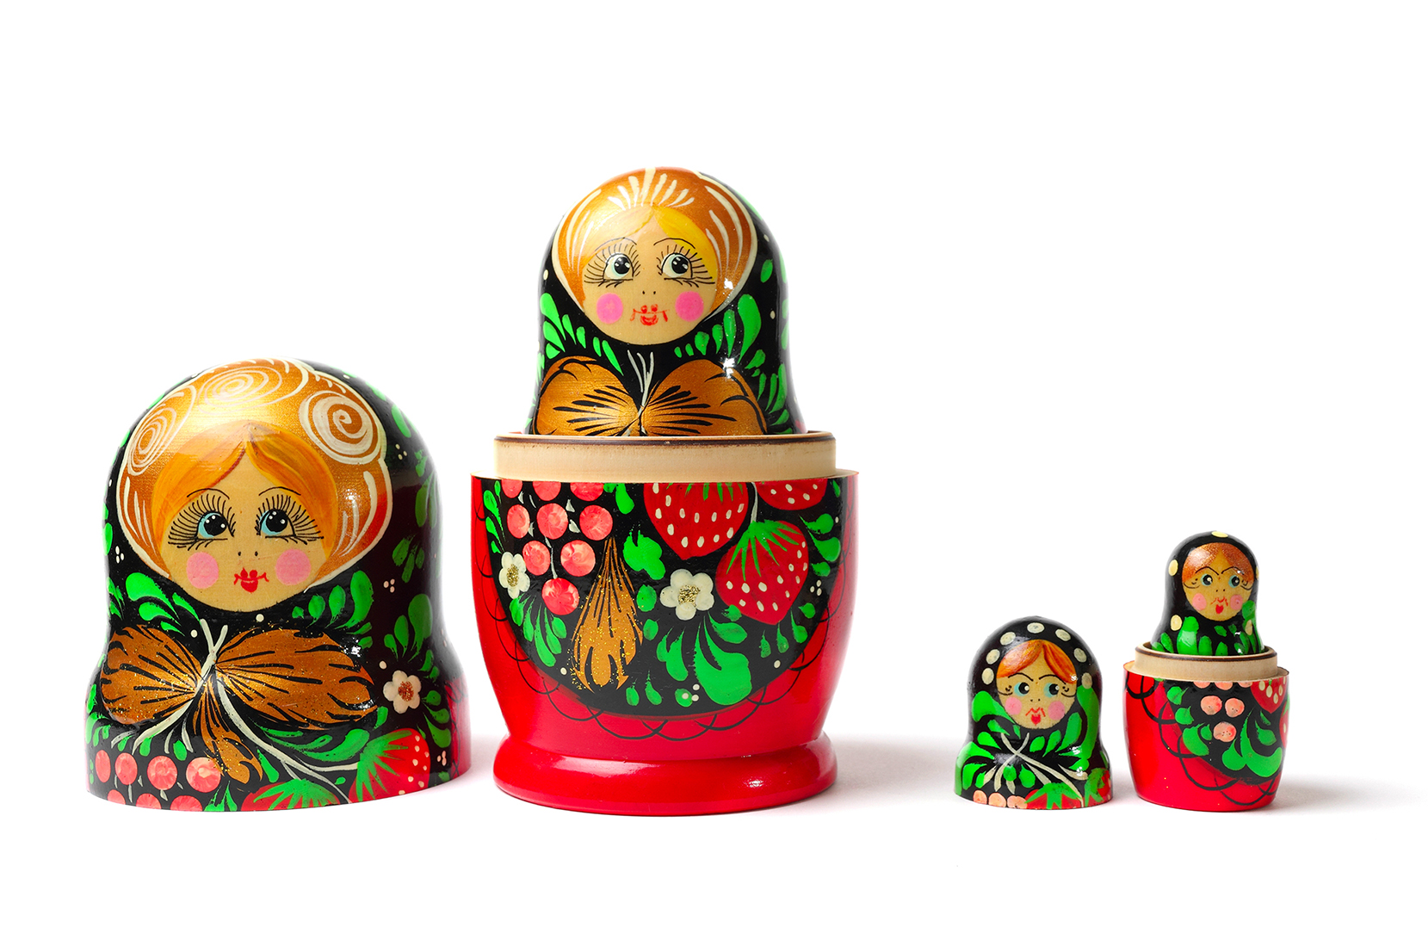
NESTING – 3D CONCEPTS
Notes:
Image: Dreamstime 27600482
Instructor guidelines:
Russian babushka (nesting dolls) are used as a vehicle to shift to a 3D mentality and to foster discussion of 3D stacking of parts.
Instructor notes:
Explain: Have you all seen Russian babushka dolls? For those that haven’t, these nesting dolls place smaller, but identical dolls within the largest doll. Typically, there will be four to six dolls in on package.
These nesting dolls are a perfect example for 3D nesting; they take up less space when placed within one another. But they are manufactured individually and then nested. This is one concept that can apply to 3D printing.

Slide 27

NESTING – 3D CONCEPTS
Notes:
Image: Dreamstime 5024276
Instructor guidelines:
Russian babushka (nesting dolls) are used as a vehicle to shift to a 3D mentality and to foster discussion of 3D stacking of parts.
Instructor notes:
Explain: If produced with 3D printing, one way to build more in each run is to nest them tightly with each doll printed in its own area on the build platform.

Slide 28

NESTING
STACKING
Notes:
Image: Dreamstime 21820578
Instructor guidelines:
Russian babushka (nesting dolls) are used as a vehicle to shift to a 3D mentality and to foster discussion of 3D stacking of parts.
Instructor notes:
Explain: But there is another option: nesting them within each other while building. For example, the diagram on the right, which would be a top view of one layer during a build, shows 9 complete dolls, each with 4 sizes.
Ask: what advantages would this have?
Explain: Correct: You would print more dolls per build. This would give you higher throughput and lower costs, since there is less build time per part.
Ask: Is this possible with all technologies? Is it a good idea?

Slide 29
NESTING
STACKING
Notes:
Instructor guidelines:
Clarify that stacking is an option for some 3D printers
Instructor notes:
Explain: Obviously, the diagram on the right shows a more efficient nesting layout. Without stacking parts within/on top of each other, we could only make 3 complete dolls in the same build area. (Largest circle for each dolls is dashed to easily show 3 dolls).
For some technologies, you can maximize your yield and minimize cycle time per part by stacking parts on top of one another. This is most commonly done in powder bed technologies, because support structures are not needed…the loose powder that surrounds a part holds it in place.
But its not an advisable strategy, generally speaking, for many 3D printing processes. So they would have to use the un-stacked nesting option.
Ask: why is that?
Explain: Correct, the reason is that support material may affect part quality. For example, FDM has rigid supports that would contact the lower part. If not using soluble supports, removal could damage the surface. Another example is PolyJet, its support material isn’t rigid, so it doesn’t make a great base upon which to build a part above.
Stacking isn’t impossible with FDM or PolyJet. It is just something that needs to be carefully considered.

Slide 30
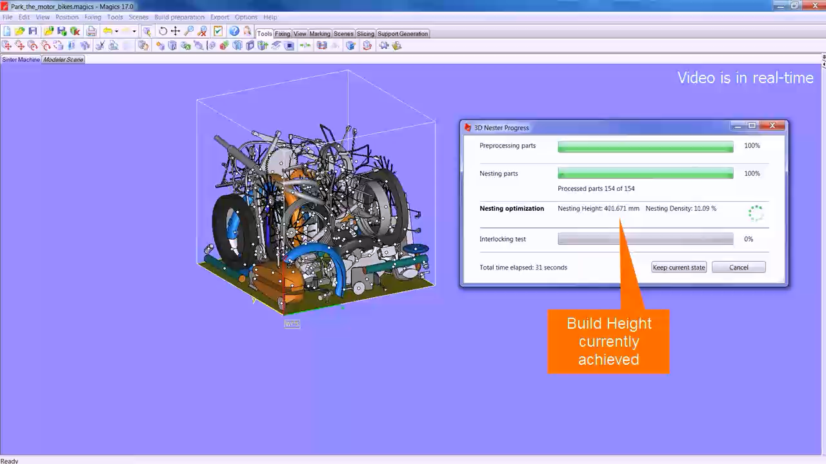
NESTING – AUTOMATIC LAYOUT
Notes:
Video: need to get approval from Materialise to use.
Instructor guidelines:
Video shows automated nesting/stacking for the laser sintering process
Instructor notes:
Explain: We already saw automated nesting for 2D layouts. That capability also exists for 3D stacking and nesting.
Click: Launch video
Explain: That is a time saver. Just imagine how long that would take to do manually.
Please note that this software is used only for the plastic laser sintering process.

Slide 31
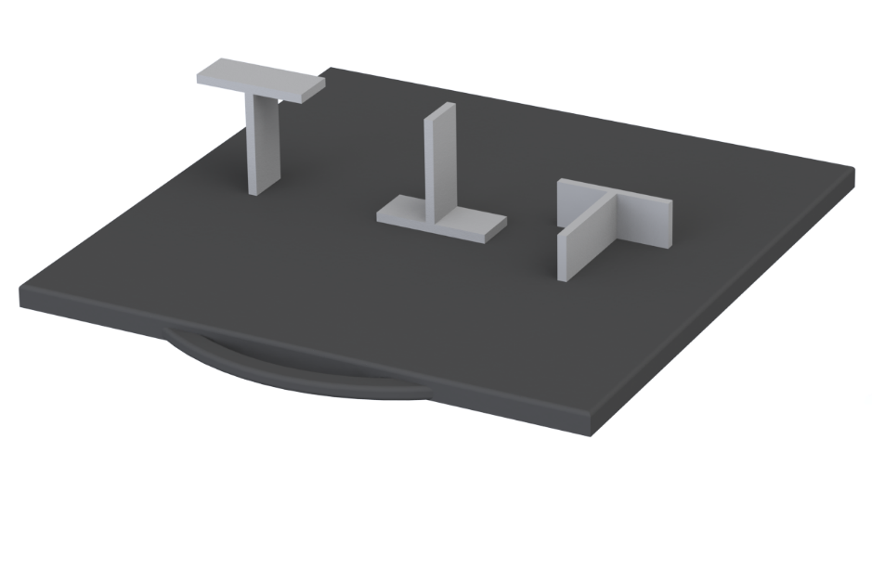
NESTING - CONSIDERATIONS
ORIENTATION
Notes:
Instructor guidelines:
Now cover considerations for 3D nesting. Note that this tutorial only covers aspect related to nesting. For example, all of the considerations that go into part orientation are NOT covered.
Instructor notes:
Explain: Before parts are nested, you first need to decide the orientation of the part. Orientation has an affect on:
Build time – for example, taller parts take more time
Material used – orientations can affect the amount of support material used (which can also affect time)
Feature details and surface finish
And even part strength – layers create a grain similar to wood
Explain: If we look at three orientations for this part, the one on the right would be the fastest, since it has the smallest Z height and the least amount of support needed. It would also be the one that can have the highest pack density.

Slide 32
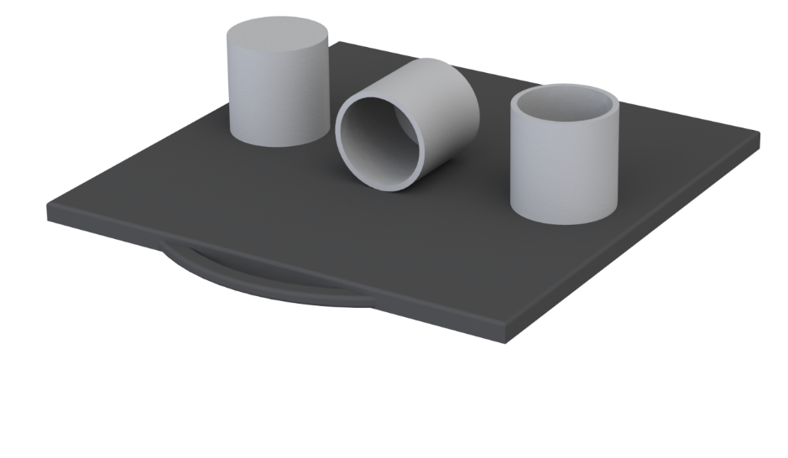
NESTING - CONSIDERATIONS
ORIENTATION
Notes:
Instructor guidelines:
Now cover considerations for 3D nesting. Note that this tutorial only covers aspect related to nesting. For example, all of the considerations that go into part orientation are NOT covered.
Instructor notes:
Explain: But the smallest Z height isn’t always the best option. Laying the cylinder on its side will stair-step the inner and outer walls. It may also need supports on the inside, which can add some time and cost. The best option in this case is the upright orientation on the right. The cylinder will have an accurate profile and there will be minimal supports.

Slide 33
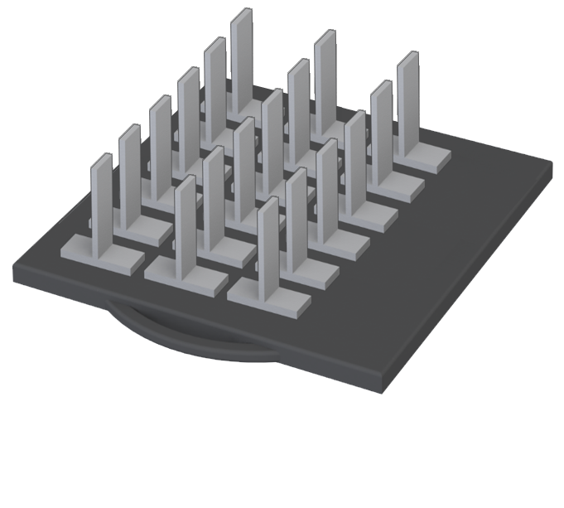
NESTING - CONSIDERATIONS
SPACING
Notes:
Instructor guidelines:
Discuss spacing between parts.
Instructor notes:
Explain: After deciding the orientation, next you nest the parts on the build tray. As with 2D nesting, you want to pack them as tightly as possible to get the most parts out of a run. This decreases the time and cost per part. But, as we saw with 2D nesting, you can’t butt parts against one another. Each technology will have a recommended spacing distance between parts and between parts and the edge of the build area.
With this layout, we can’t quite fit a fourth row of parts. So...

Slide 34
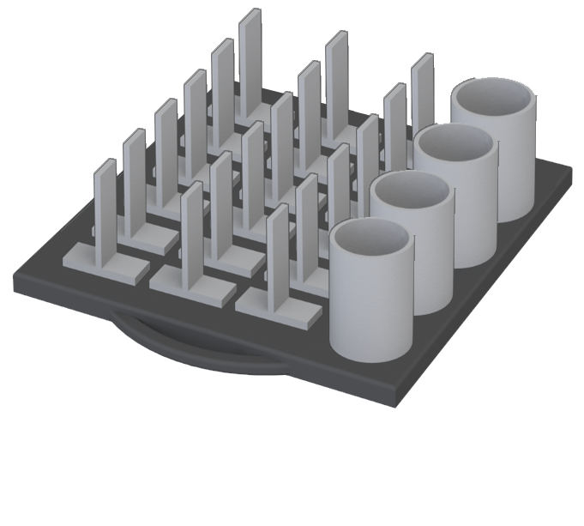
NESTING – CONSIDERATIONS
VARIED PARTS
Notes:
Instructor guidelines:
Discuss build dissimilar parts to use up any available space.
Instructor notes:
Explain: …we place another type of part in the empty space. But when you do, you will need to be considerate of the total build time. Adding more parts may extend build completion that affects scheduling. For example, if more parts extends the build time by a few hours and that means you can’t start another job before leaving for the day, your total throughput will be less when building more in the first run.

Slide 35
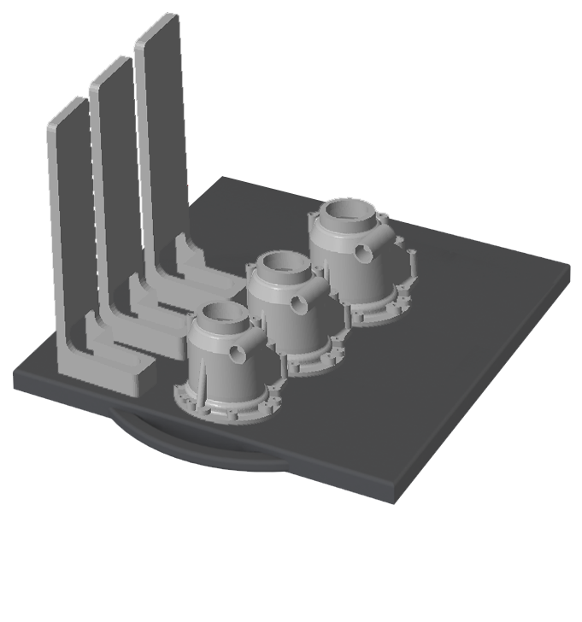
NESTING – CONSIDERATIONS
PART HEIGHTS
Notes:
Instructor guidelines:
Discuss part height considerations.
Instructor notes:
Explain: That would be especially true if you added much taller parts.
Explain: All 3D printing processes have unproductive overhead built into the process. This is time for the printer to do something other than making the actual part, and this time happens on each and every layer. So taller parts take longer to build.
Explain: In this example, adding the three smaller parts won’t add any overhead time, so they are along for the ride. But if the taller parts were added to the smaller parts, overhead time will significantly increase. The rule of thumb is to try to build similar height parts in each run and to avoid adding one tall part to an otherwise short build.

Slide 36
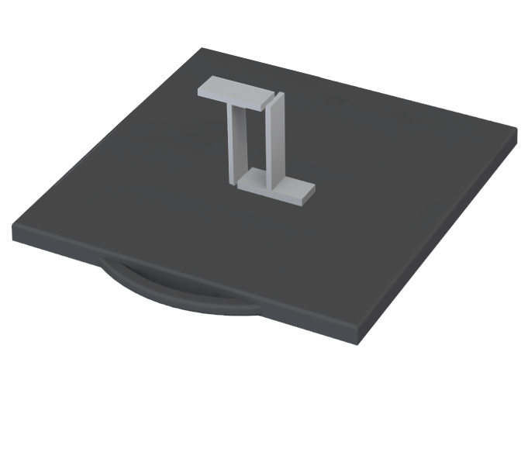
NESTING – CONSIDERATIONS
OVERLAP
Notes:
Instructor guidelines:
Discuss overlapping parts.
Instructor notes:
Explain: The last consideration we will cover is overlapping parts, as shown above. While there are some exceptions, generally one part cannot invade the largest top-down profile of a neighbor.

Slide 37
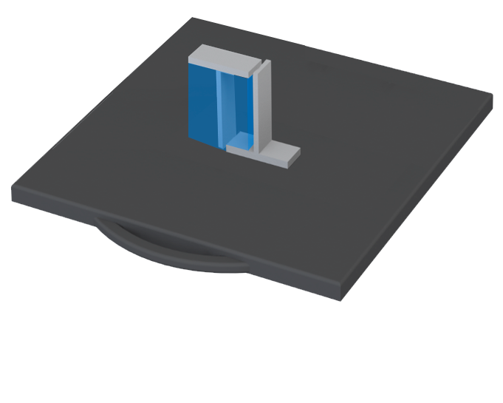
NESTING – CONSIDERATIONS
OVERLAP
Notes:
Instructor guidelines:
Discuss overlapping parts.
Instructor notes:
Explain: Imagine the transparent blue box as the part’s shadow if light is shining down from directly above. That would be the zone that other parts could not impinge upon. To make a valid layout, the right-hand part would need to shift to the right to clear the left-hand part’s top-down profile by an amount specified by the 3D printing technology.
Explain: There is one exception. That would be with powder bed processes where the loose powder holds a part, so support structures are not needed. There is still a minimum spacing between parts, but overlapping is allowed.

Slide 38
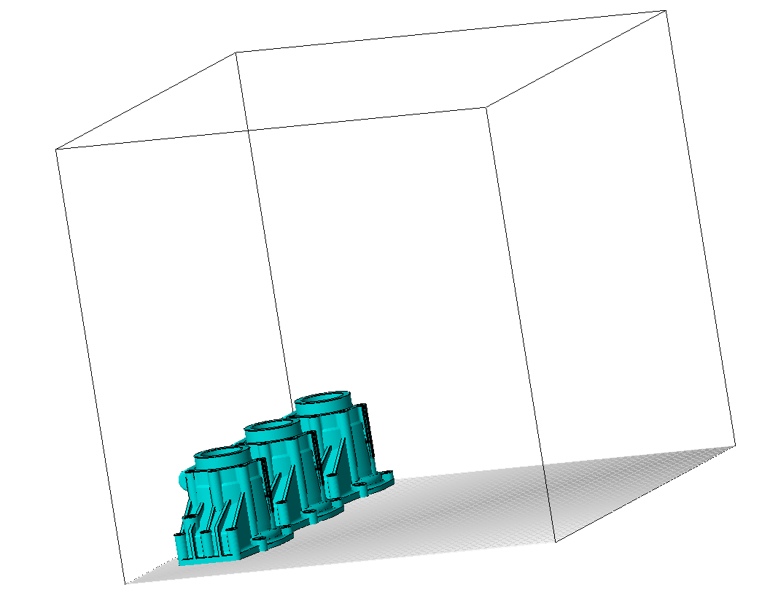
NESTING - ADVANTAGES
DECREASING WASTE
Notes:
Instructor guidelines:
Cover the advantages of nesting for 3D applications
Instructor notes:
Explain: Remember the cookie dough or cookie sheet analogy. This is where the difference is the greatest.
Explain: Unlike 2D nesting, decreasing waste isn’t always an advantage of nesting, at least when considering the material that goes into the part.
Explain: For technologies that deposit material, nesting doesn’t change the amount of material or the amount of waste. Since technologies like Fused Deposition Modeling and PolyJet, deposit material only where needed, there is no waste. So the primary advantages of nesting are lowering time and increasing throughput, which when combined lower costs. These are the cookie sheet examples; placing parts as close together as possible and filling every square inch to get the most out of each batch.

Slide 39
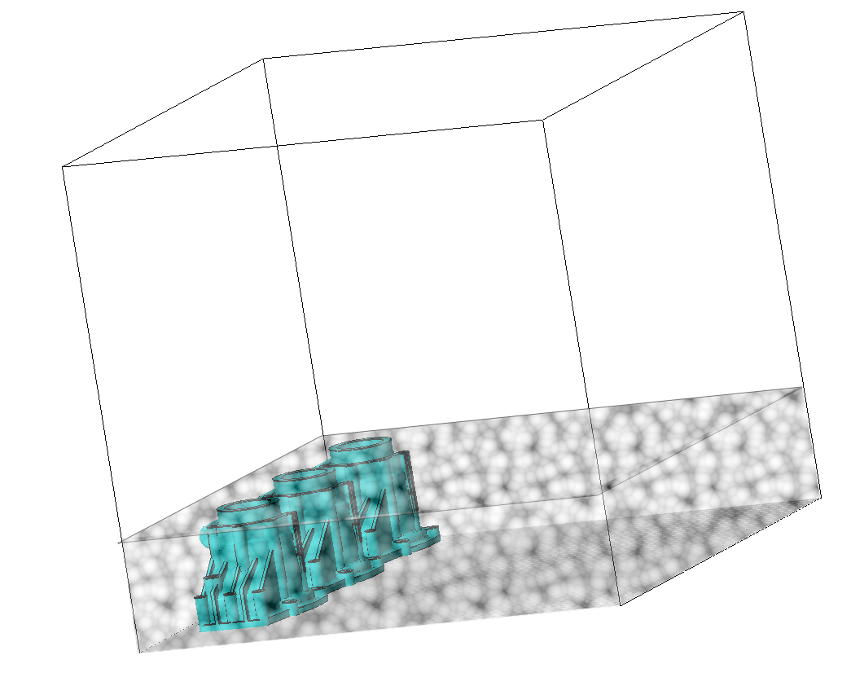

NESTING - ADVANTAGES
DECREASING WASTE
Notes:
Instructor guidelines:
Cover the advantages of nesting for 3D applications
Instructor notes:
Explain: Where waste can be decreased is in the cookie dough technologies. For powder bed technologies, the parts are surrounded with powder. That powder fills the entire build chamber up to the height of the tallest part. So the more parts placed in the build, the less powder there is to remove.
Explain: Now, all of that powder isn’t scrap. It can be recycled and placed back in the machine. But not all of the recycled material will be reused. For example, with laser sintering of plastics, only a percentage, about 30%, of the unused powder in a build is reused. So if a layer contains more parts, there is less scrap.

Slide 40
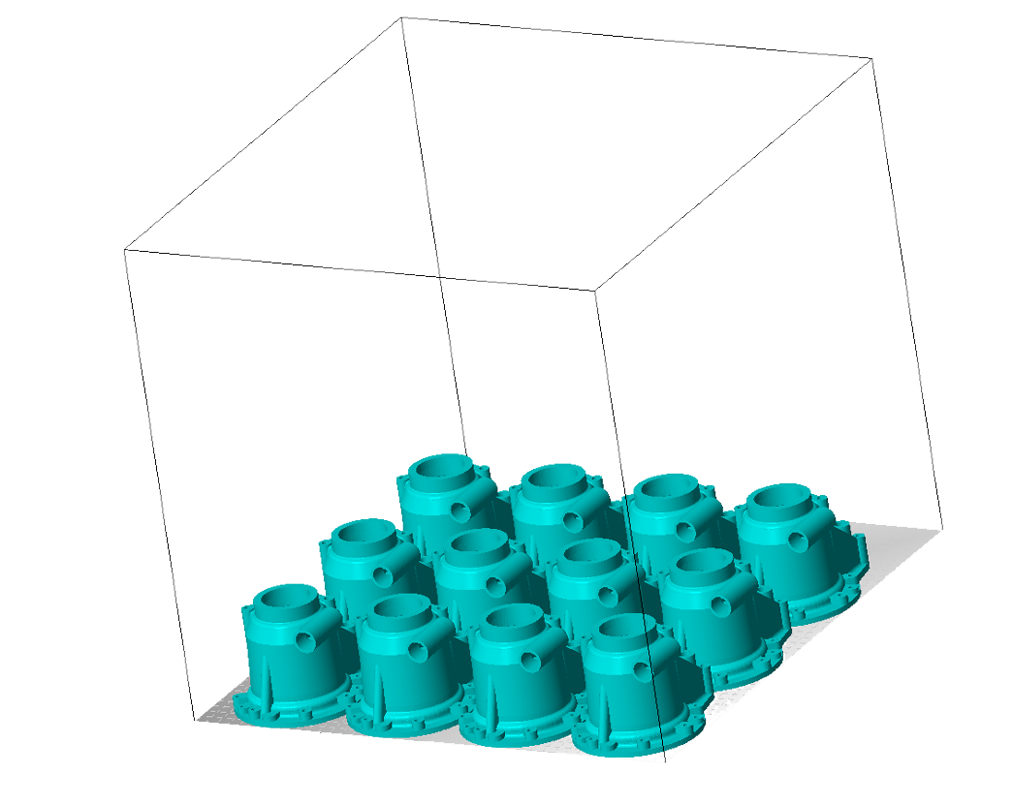
NESTING - ADVANTAGES
INCREASING YIELD
Notes:
Instructor guidelines:
Cover the primary goal of increasing the yield per build.
Instructor notes:
Explain: Across the board, it is always faster, as measured by time per part, to pack as many parts into a build as possible. So a primary advantage of densely nested parts is a higher yield per run, which decreases operating time and cost.
Which we can clearly see in the next slide.

Slide 41
NESTING - ADVANTAGES
DECREASING TIME
Overhead per layer
Print time per part
Total time
Combined: 15 hrs
Separate: 45 hrs
Notes:
Instructor guidelines:
Deeper discussion on time.
Instructor notes:
Explain: As previously stated, total build time has two components: the overhead per layer and the print time per part. Nesting won’t change the print time for each part. And it won’t change the overhead time for a build. But it does allow us to amortize that overhead across more parts to reduce the total time per part.
In this example, the six nested parts take 15 hours to build. This is an average per part of 2.5 hours each.
If each part were built individually, the total time would be 45 hours. That would be an average of 7.5 hours each, three greater.

Slide 42
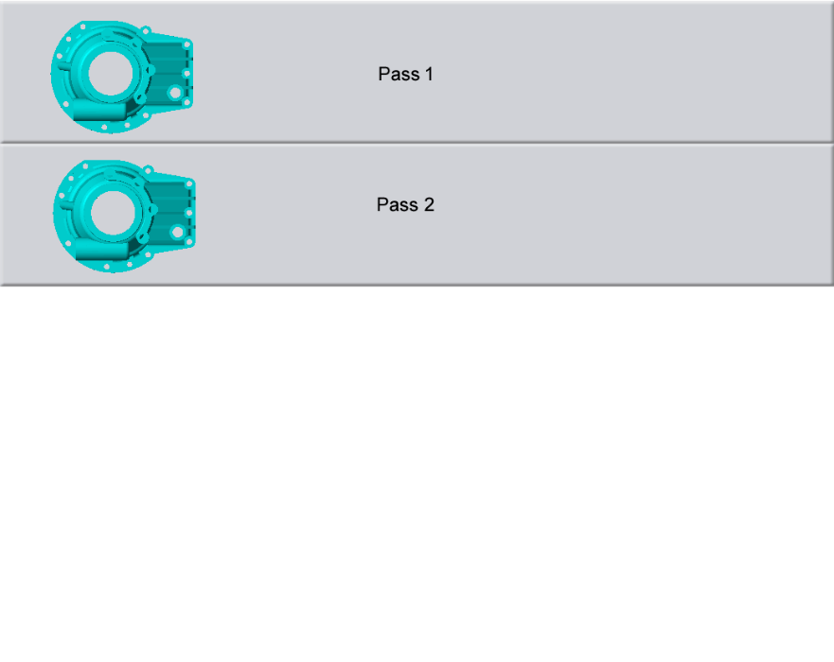
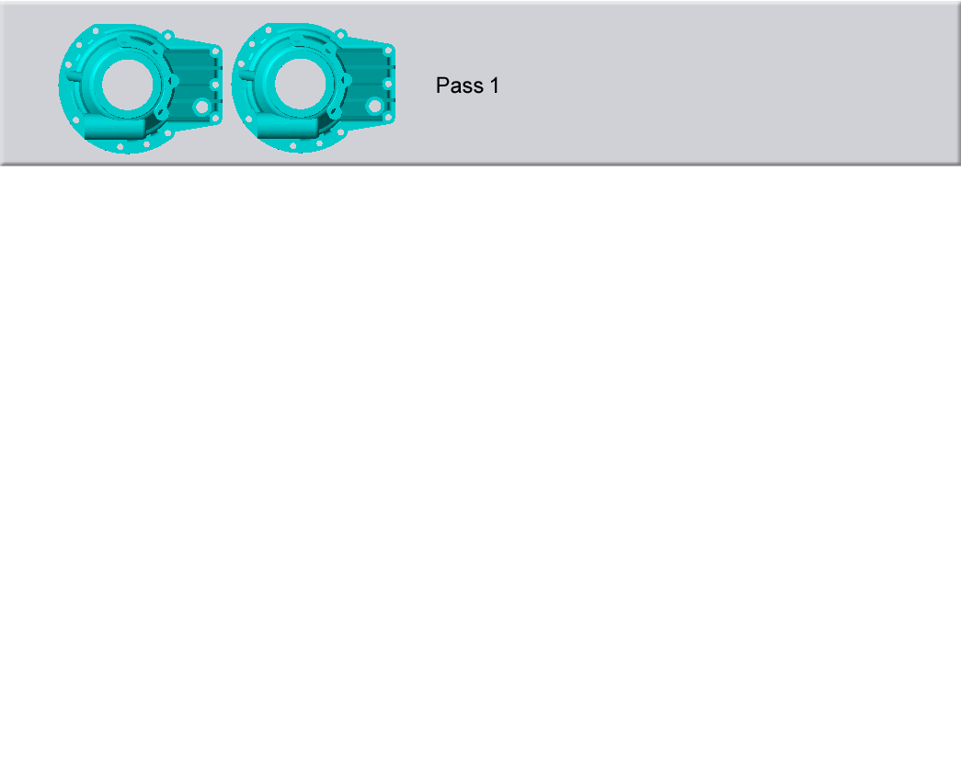
NESTING - ADVANTAGES
DECREASING TIME
Overhead per layer
Print time per part
Total time
Notes:
Instructor guidelines:
Deeper discussion on time.
Instructor notes:
Explain: When building partial trays, nesting can play a role in reducing overhead time. For example, with the PolyJet process, a layout like this requires 2 passes of the print head. Each pass takes about six seconds. If these parts were 3 inches tall, there would be 5,000 layers when building in high quality mode.
6 seconds times 5,000 layers is 8.3 hours!
Click: Advance animation
Explain: Want to save 8.3 hours on a build? Simple nest the parts so they are all in one print head pass.

Slide 43
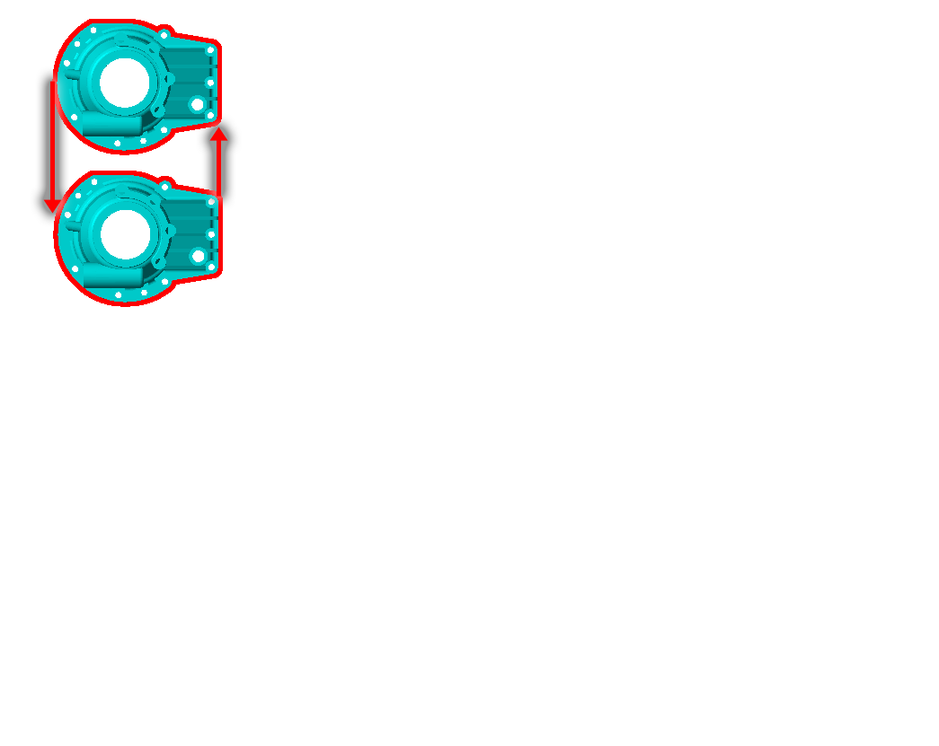
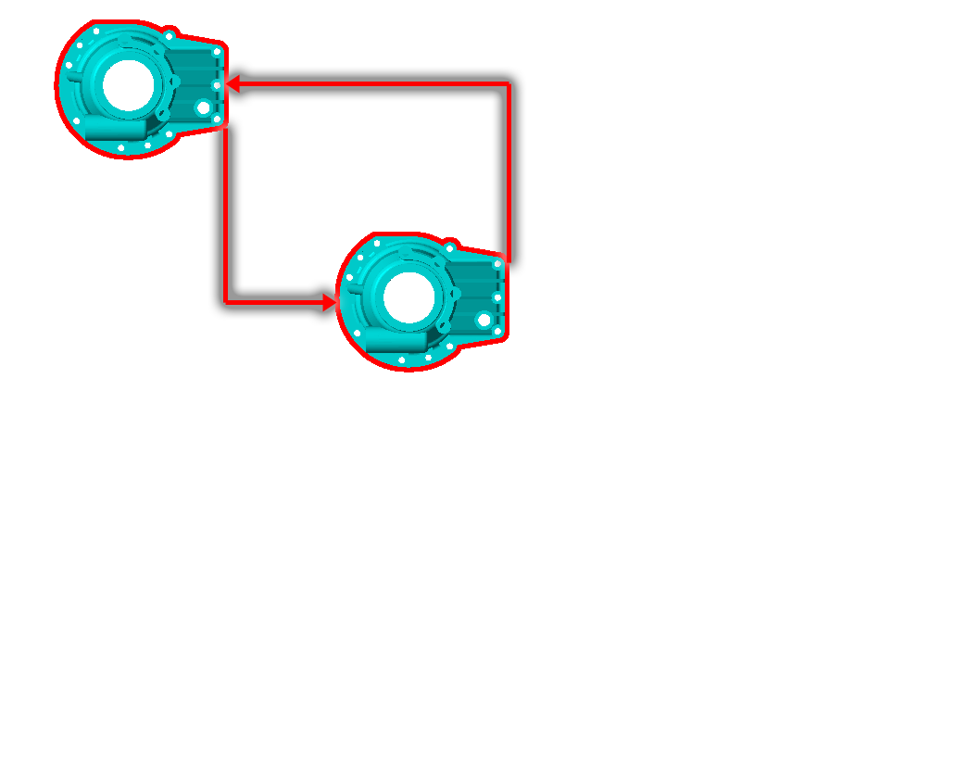
NESTING - ADVANTAGES
DECREASING TIME
Overhead per layer
Print time per part
Total time
Notes:
Instructor guidelines:
Deeper discussion on time.
Instructor notes:
Explain: And here’s another example. This time from FDM.
If we place these to parts far apart, the extrusion head has to travel farther as it moves from one part to another. That is unproductive time, much like spacing the cookies far apart.
This is true for many technologies, including those that user lasers, cutters and electron beams. For some of these, the travel between parts may be repeated many times on one layer, since the laser will work a little on one part, go to the next to do a little work and come back again.
When an extrusion head or laser is traveling at 10 to 250 inches a second, it doesn’t seem like much. But as with the last example, when multiplied over thousands of layers, the time adds up.
Click: Advance animation
Explain: So the simple thing to do to decrease build time is to place the parts closer together.

Slide 44
IN THIS LESSON
Nesting concepts: 2D
Nesting concepts: 3D
Nesting for 3D printing
PolyJet
Fused Deposition Modeling
Notes:
Instructor guidelines:
The third and final selection walks students through the steps and considerations when nesting parts for PolyJet or FDM
Instructor notes:
Explain: Now that we’ve covered the advantages and considerations, let’s take a look at how nesting is done for PolyJet and Fused Deposition Modeling. We’ll start with PolyJet.

Slide 45
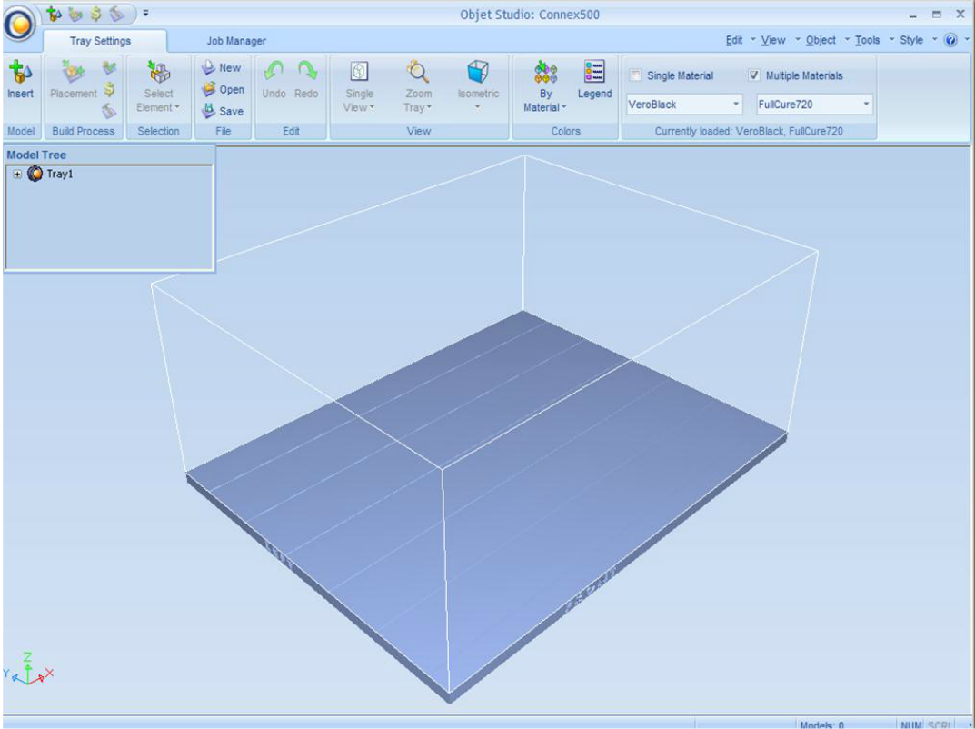
POLYJET – OBJET STUDIO
OPEN OBJET STUDIO
Click Insert.
IMPORT FILES
PLACE MODELS
ADJUST POSITIONS
FINALIZE JOB
PRINT MODELS
Notes:
Instructor guidelines:
This section covers the steps in Objet Studio related to nesting. Note that it is not a comprehensive tutorial on the software or part set up for PolyJet.
Instructor notes:
Explain: The software for setting up PolyJet builds is called Objet Studio. To get started, launch Objet Studio.
Click: Advance animation
Explain: and click the Insert icon. This will give you the option to import one or many STL files at a time.

Slide 46
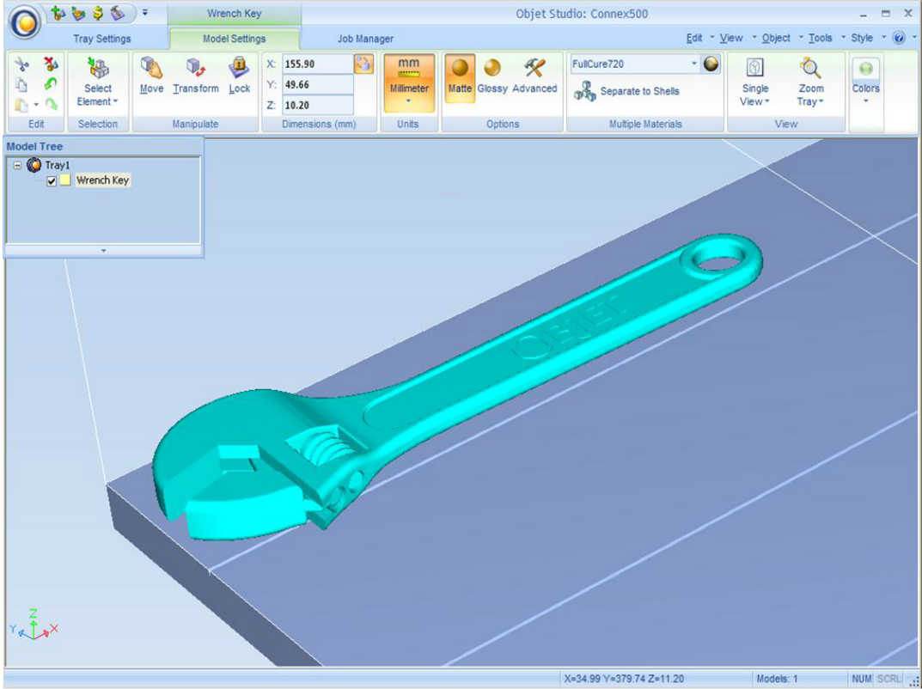
POLYJET – OBJET STUDIO
OPEN OBJET STUDIO
IMPORT FILES
PLACE MODELS
ADJUST POSITIONS
FINALIZE JOB
PRINT MODELS
Notes:
Instructor guidelines:
This section covers the steps in Objet Studio related to nesting. Note that it is not a comprehensive tutorial on the software or part set up for PolyJet.
Instructor notes:
Explain: Objet Studio will do its best to orient and place the models to minimize build time and the amount of support material. But it won’t always know what is important to you. So, you may need to do a little work to place, position and nest parts for the fastest builds and lowest costs.

Slide 47
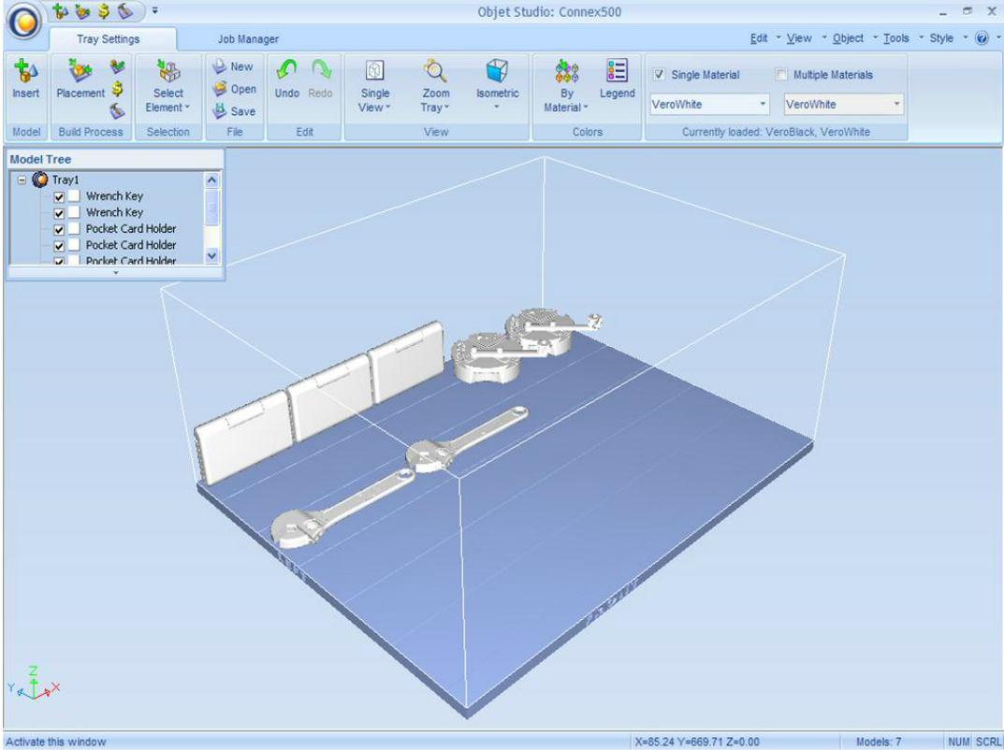
POLYJET – OBJET STUDIO
OPEN OBJET STUDIO
Click Placement.
IMPORT FILES
PLACE MODELS
ADJUST POSITIONS
FINALIZE JOB
PRINT MODELS
Notes:
Instructor guidelines:
This section covers the steps in Objet Studio related to nesting. Note that it is not a comprehensive tutorial on the software or part set up for PolyJet.
Instructor notes:
Explain: For this job, we have 7 parts that Objet Studio oriented and placed on the tray. As you can see, the nesting leaves a lot of open space and the first 3 parts are standing on end. This will make the print job much longer than it needs to be.
Click: Advance animation
Explain: To fix that, click on the Placement icon. It will give you two options: automatic, which is recommended, and manual. If we select the automatic option, here’s what the nesting looks like.

Slide 48
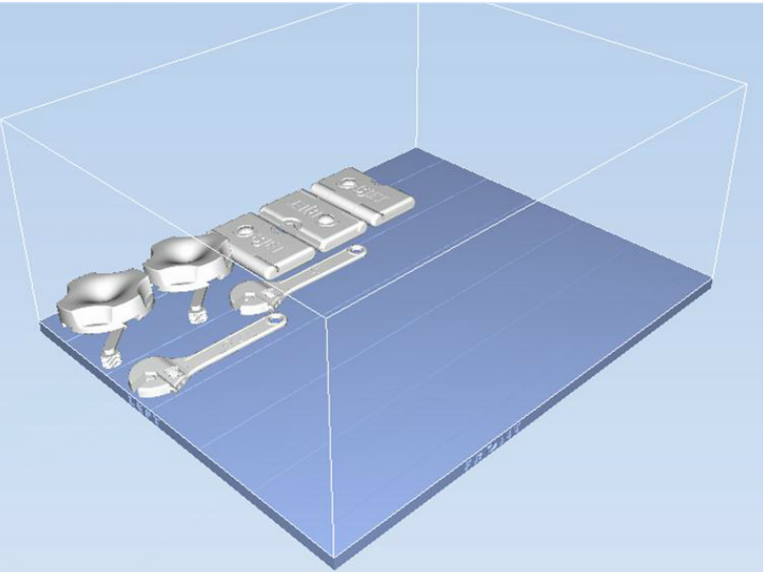
POLYJET – OBJET STUDIO
OPEN OBJET STUDIO
IMPORT FILES
PLACE MODELS
ADJUST POSITIONS
FINALIZE JOB
PRINT MODELS
Notes:
Instructor guidelines:
This section covers the steps in Objet Studio related to nesting. Note that it is not a comprehensive tutorial on the software or part set up for PolyJet.
Instructor notes:
Explain: As you can see, the parts are tightly nested along both the X and Y axes. That will give us the fastest build time.
Click: Advance animation

Slide 49
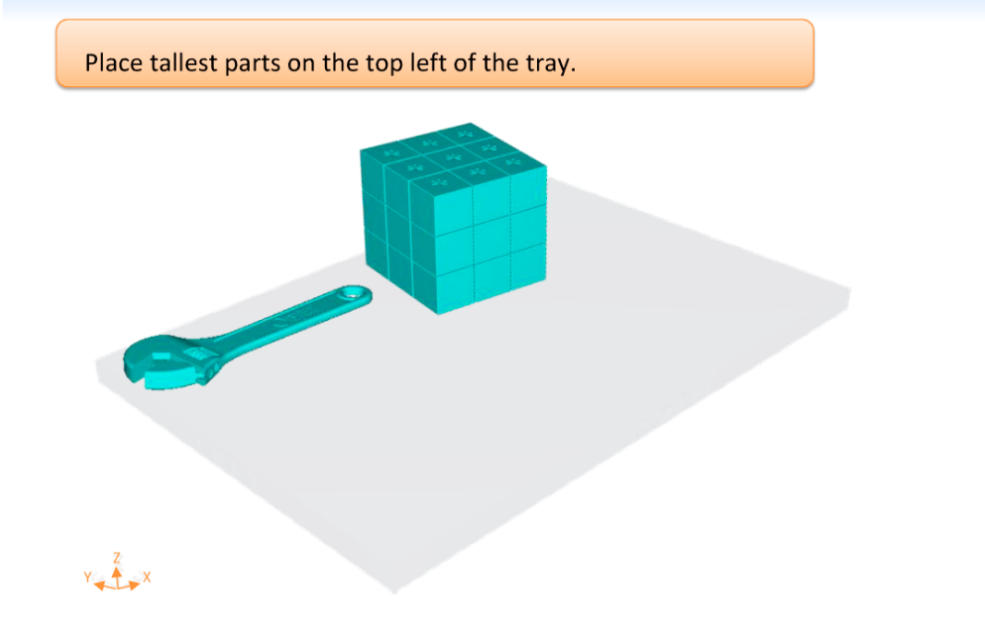
POLYJET – OBJET STUDIO
OPEN OBJET STUDIO
IMPORT FILES
PLACE MODELS
ADJUST POSITIONS
FINALIZE JOB
Print head travel
PRINT MODELS
Notes:
Instructor guidelines:
This section covers the steps in Objet Studio related to nesting. Note that it is not a comprehensive tutorial on the software or part set up for PolyJet.
Instructor notes:
Explain: As you may have noticed on the last slide, the tallest parts were in the first print head pass at the farthest left. This minimizes print head travel, which makes the process faster.
If the tallest parts were at the far right, the print head would have to travel the entire length of the build tray for every layer.

Slide 50
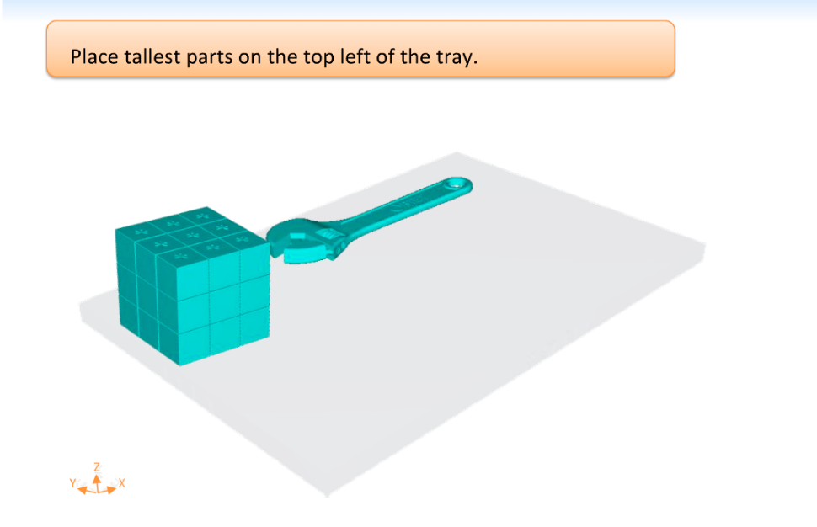
POLYJET – OBJET STUDIO
OPEN OBJET STUDIO
IMPORT FILES
PLACE MODELS
ADJUST POSITIONS
FINALIZE JOB
Print head travel
PRINT MODELS
Notes:
Instructor guidelines:
This section covers the steps in Objet Studio related to nesting. Note that it is not a comprehensive tutorial on the software or part set up for PolyJet.
Instructor notes:
Explain: But if the tallest part is on the left, the print head travels a shorter distance once the smaller parts are complete.

Slide 51
POLYJET – OBJET STUDIO
OPEN OBJET STUDIO
Select material.
IMPORT FILES
PLACE MODELS
ADJUST POSITIONS
FINALIZE JOB
PRINT MODELS
Notes:
Instructor guidelines:
This section covers the steps in Objet Studio related to nesting. Note that it is not a comprehensive tutorial on the software or part set up for PolyJet.
Instructor notes:
Explain: And that’s it for nesting parts in Objet Studio.
Click: Advance animation
Explain: But there is more to do to prepare the parts for printing, such as selecting the desired material.

Slide 52
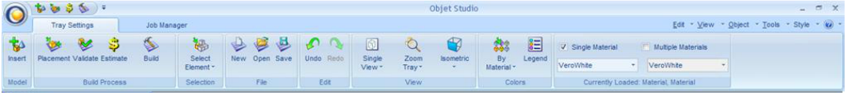
POLYJET – OBJET STUDIO
Click Validate.
OPEN OBJET STUDIO
Click Build.
IMPORT FILES
PLACE MODELS
ADJUST POSITIONS
FINALIZE JOB
PRINT MODELS
Notes:
Instructor guidelines:
This section covers the steps in Objet Studio related to nesting. Note that it is not a comprehensive tutorial on the software or part set up for PolyJet.
Instructor notes:
Explain: To finish up, you will click the Validate icon.
Click: Advance animation
Explain: This checks your layout to make sure there aren’t any problems such as over lapping parts.
Click: Advance animation
Explain: Then you can click the Build icon to start the 3D printing process.

Slide 53
IN THIS LESSON
Nesting concepts: 2D
Nesting concepts: 3D
Nesting for 3D printing
PolyJet
Fused Deposition Modeling
Notes:
Instructor guidelines:
The third and final selection walks students through the steps and considerations when nesting parts for PolyJet or FDM
Instructor notes:
Explain: Now that we’ve covered the nesting operations for PolyJet, let’s move on to Fused Deposition Modeling.

Slide 54
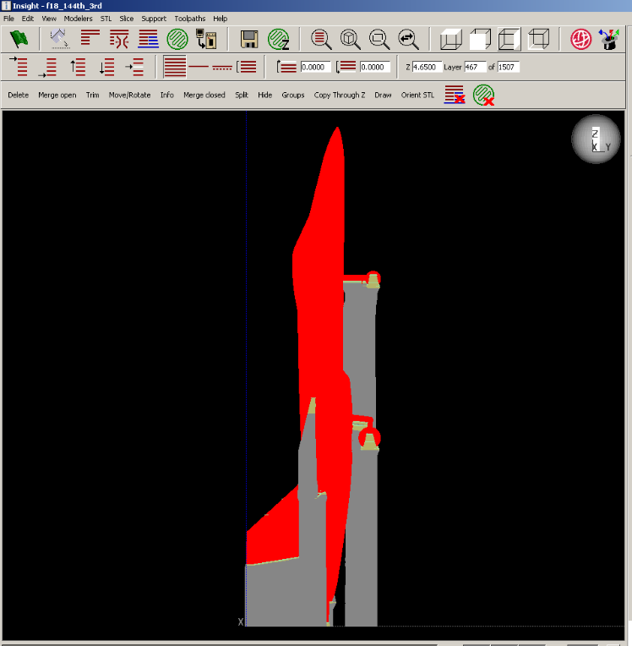
FDM - INSIGHT
INSIGHT – MODEL SETUP
OPEN IN CONTROL CENTER
PLACE MODEL
COPY/ADD MODELS
FINALIZE JOB
SEND TO MODELER
Notes:
Instructor guidelines:
This section covers the steps in Control Center related to nesting. Note that it is not a comprehensive tutorial on the software or part set up for FDM.
Instructor notes:
Explain: Fused Deposition Modeling (FDM), uses two software applications: Insight, which is where parts are oriented, supported and build settings are applied, and Control Center, which is the tool for creating the job that is sent to the printer.
This slide shows an aircraft that has been set up in Insight and saved as a CMB file.

Slide 55
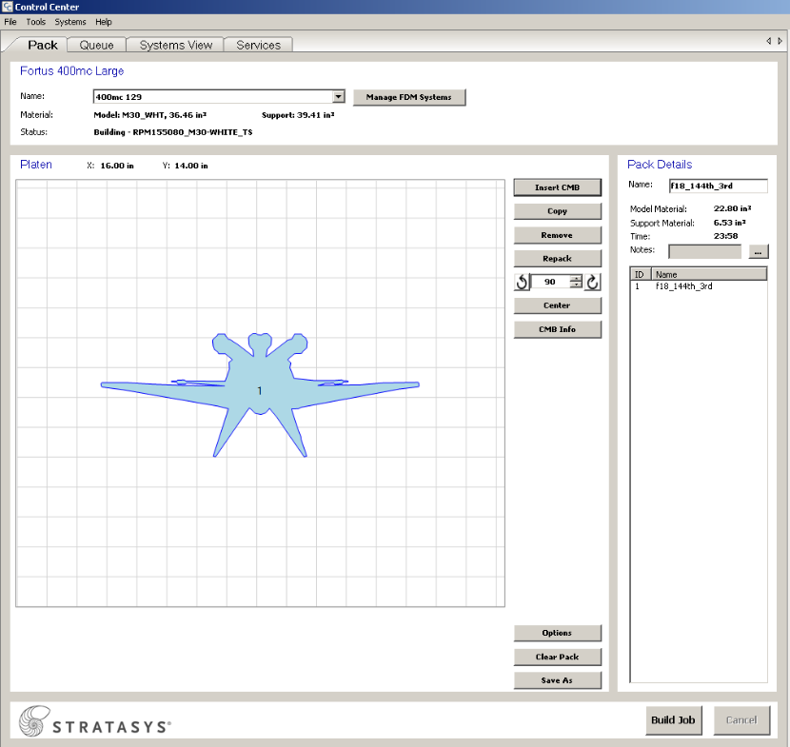
FDM - CONTROL CENTER
INSIGHT – MODEL SETUP
OPEN IN CONTROL CENTER
Click Insert CMB.
PLACE MODEL
COPY/ADD MODELS
FINALIZE JOB
SEND TO MODELER
Notes:
Instructor guidelines:
This section covers the steps in Control Center related to nesting. Note that it is not a comprehensive tutorial on the software or part set up for FDM.
Instructor notes:
Explain: After launching Control Center, you will insert files into the “pack”.
Click: Advance animation
Explain: To do that, just click on the insert CMB icon.

Slide 56
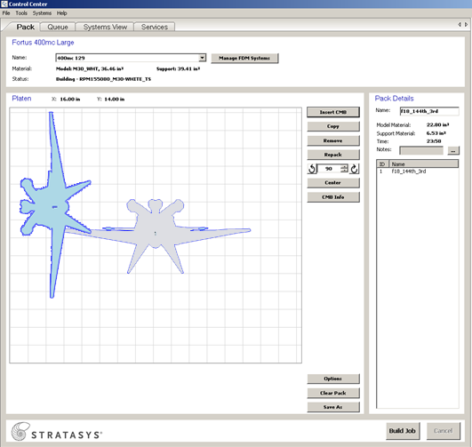
FDM - CONTROL CENTER
INSIGHT – MODEL SETUP
OPEN IN CONTROL CENTER
PLACE MODEL
COPY/ADD MODELS
FINALIZE JOB
SEND TO MODELER
Notes:
Instructor guidelines:
This section covers the steps in Control Center related to nesting. Note that it is not a comprehensive tutorial on the software or part set up for FDM.
Instructor notes:
Explain: After inserting the CMB, you are free to move and rotate the model around the build platform.

Slide 57
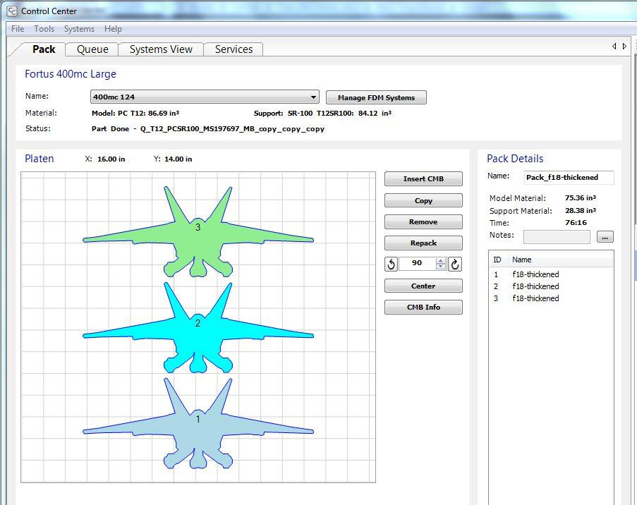
FDM - CONTROL CENTER
INSIGHT – MODEL SETUP
OPEN IN CONTROL CENTER
PLACE MODEL
COPY/ADD MODELS
FINALIZE JOB
SEND TO MODELER
Notes:
Instructor guidelines:
This section covers the steps in Control Center related to nesting. Note that it is not a comprehensive tutorial on the software or part set up for FDM.
Instructor notes:
Explain: Using the buttons shown in the red box, you can insert other CMBs, create copies of a model, rotate models and adjust their positioning. In this example, we have three aircraft that are nicely nested on the center of the platform.

Slide 58
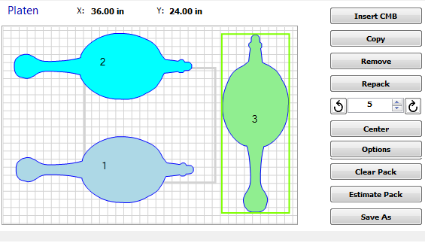
FDM - CONTROL CENTER
INSIGHT – MODEL SETUP
OPEN IN CONTROL CENTER
PLACE MODEL
COPY/ADD MODELS
FINALIZE JOB
SEND TO MODELER
Notes:
Instructor guidelines:
This section covers the steps in Control Center related to nesting. Note that it is not a comprehensive tutorial on the software or part set up for FDM.
Instructor notes:
Explain: With this model, the nesting is not as efficient as it could be. There is quite a bit of space between the parts, which increases the head travel that we spoke about earlier, and a lot of empty space.

Slide 59
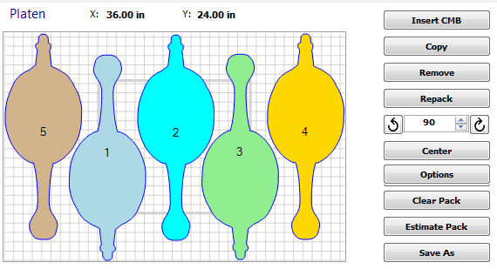
FDM - CONTROL CENTER
INSIGHT – MODEL SETUP
OPEN IN CONTROL CENTER
PLACE MODEL
COPY/ADD MODELS
FINALIZE JOB
SEND TO MODELER
Notes:
Instructor guidelines:
This section covers the steps in Control Center related to nesting. Note that it is not a comprehensive tutorial on the software or part set up for FDM.
Instructor notes:
Explain: To resolve both of those issues, we would rotate the parts so that they face both the front and back and nest them tightly. This allows us to fit 5 parts in one run.

Slide 60
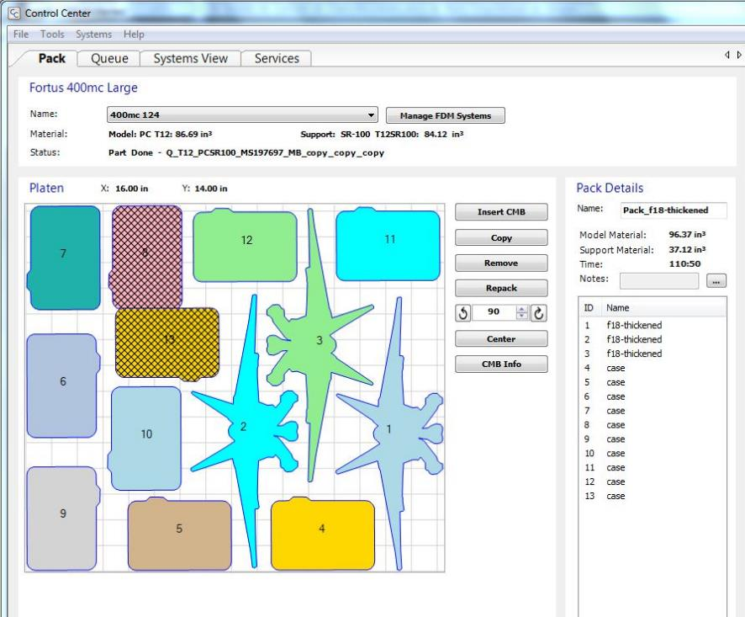
FDM - CONTROL CENTER
INSIGHT – MODEL SETUP
OPEN IN CONTROL CENTER
PLACE MODEL
COPY/ADD MODELS
FINALIZE JOB
SEND TO MODELER
Notes:
Instructor guidelines:
This section covers the steps in Control Center related to nesting. Note that it is not a comprehensive tutorial on the software or part set up for FDM.
Instructor notes:
Explain: Control Center will notify you if you have overlapping or abutting parts, as we see with the two parts that have cross hatching. The minimum space is controlled by the “gutter value”. The default is 0.25 inch. With this warning, we know that we need to reposition those two parts.

Slide 61
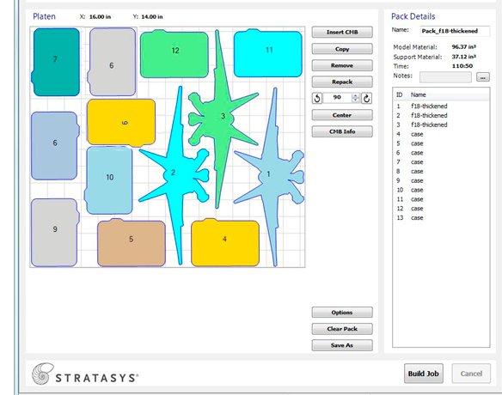
FDM - CONTROL CENTER
INSIGHT – MODEL SETUP
OPEN IN CONTROL CENTER
PLACE MODEL
COPY/ADD MODELS
FINALIZE JOB
SEND TO MODELER
Click Build Job.
Notes:
Instructor guidelines:
This section covers the steps in Control Center related to nesting. Note that it is not a comprehensive tutorial on the software or part set up for FDM.
Instructor notes:
Explain: Now that the pack has no errors and all parts are nicely nested, it is time to build the job.
Click: Advance animation
Explain: And we do that with a click of the Build Job button.
And that completes our discussion of nesting for FDM, PolyJet, 3D printing in general and 2D manufacturing processes.

Slide 62
IN THIS LESSON
Nesting concepts: 2D
Nesting concepts: 3D
Nesting for 3D printing
PolyJet
Fused Deposition Modeling

Slide 63
LEGAL
This document is part of the Stratasys Education Open Curriculum Program and is subject to Stratasys Education Open Curriculum Program - Terms of use available at http://www.stratasys.com/industries/education/educators/curriculum/terms-of-use. Notwithstanding the foregoing, the information provided herein, including any data, material and/or content (“Content”), is provided for informational purposes only. The Content is provided “as is”. Stratasys makes no representations or warranties in relation to the Content. Permission is granted to you to display, copy, distribute, and download the Content for your own internal use only, You may not, however disclose, copy, reproduce, distribute, publish, display, transmit, sell or offer for resale, the Content, or any part thereof, outside of your organization , without Stratasys’ express written permission.
© 2014 Stratasys. All rights reserved. Stratasys, Stratasys logo, Objet, For a 3D World, PolyJet, FDM, FDM Technology, Fortus, Finishing Touch, Insight, ABSplus, ABS-ESD7, ABS - M30, ABS – M30i, ABSi, PC – ISO, SR-20, SR-30, SR-100, SR-110, WaterWorks, Mojo, Dimension, Catalyst, WaveWash, WaveWash 55, Ecoworks, uPrint, Objet Studio, FullCure, Eden, Connex, Tango, Vero, VeroDent, Durus, Endur, PolyJet Matrix, Digital ABS and Digital ABS2 are trademarks of Stratasys Ltd. and/or its subsidiaries or affiliates and may be registered in certain jurisdictions. PowerPoint is a registered trademark of Microsoft Corporation in the United States and/or other countries. QuickTime is a trademark of Apple Inc., registered in the U.S. and other countries. All other trademarks belong to their respective owners.

Slide 64
Thank you.

